Slide 1


Autodesk EAGLE
Lecture 1
UIowa IEEE
Electronics
As Simple As Possible

Slide 2
What is EAGLE?

Slide 3
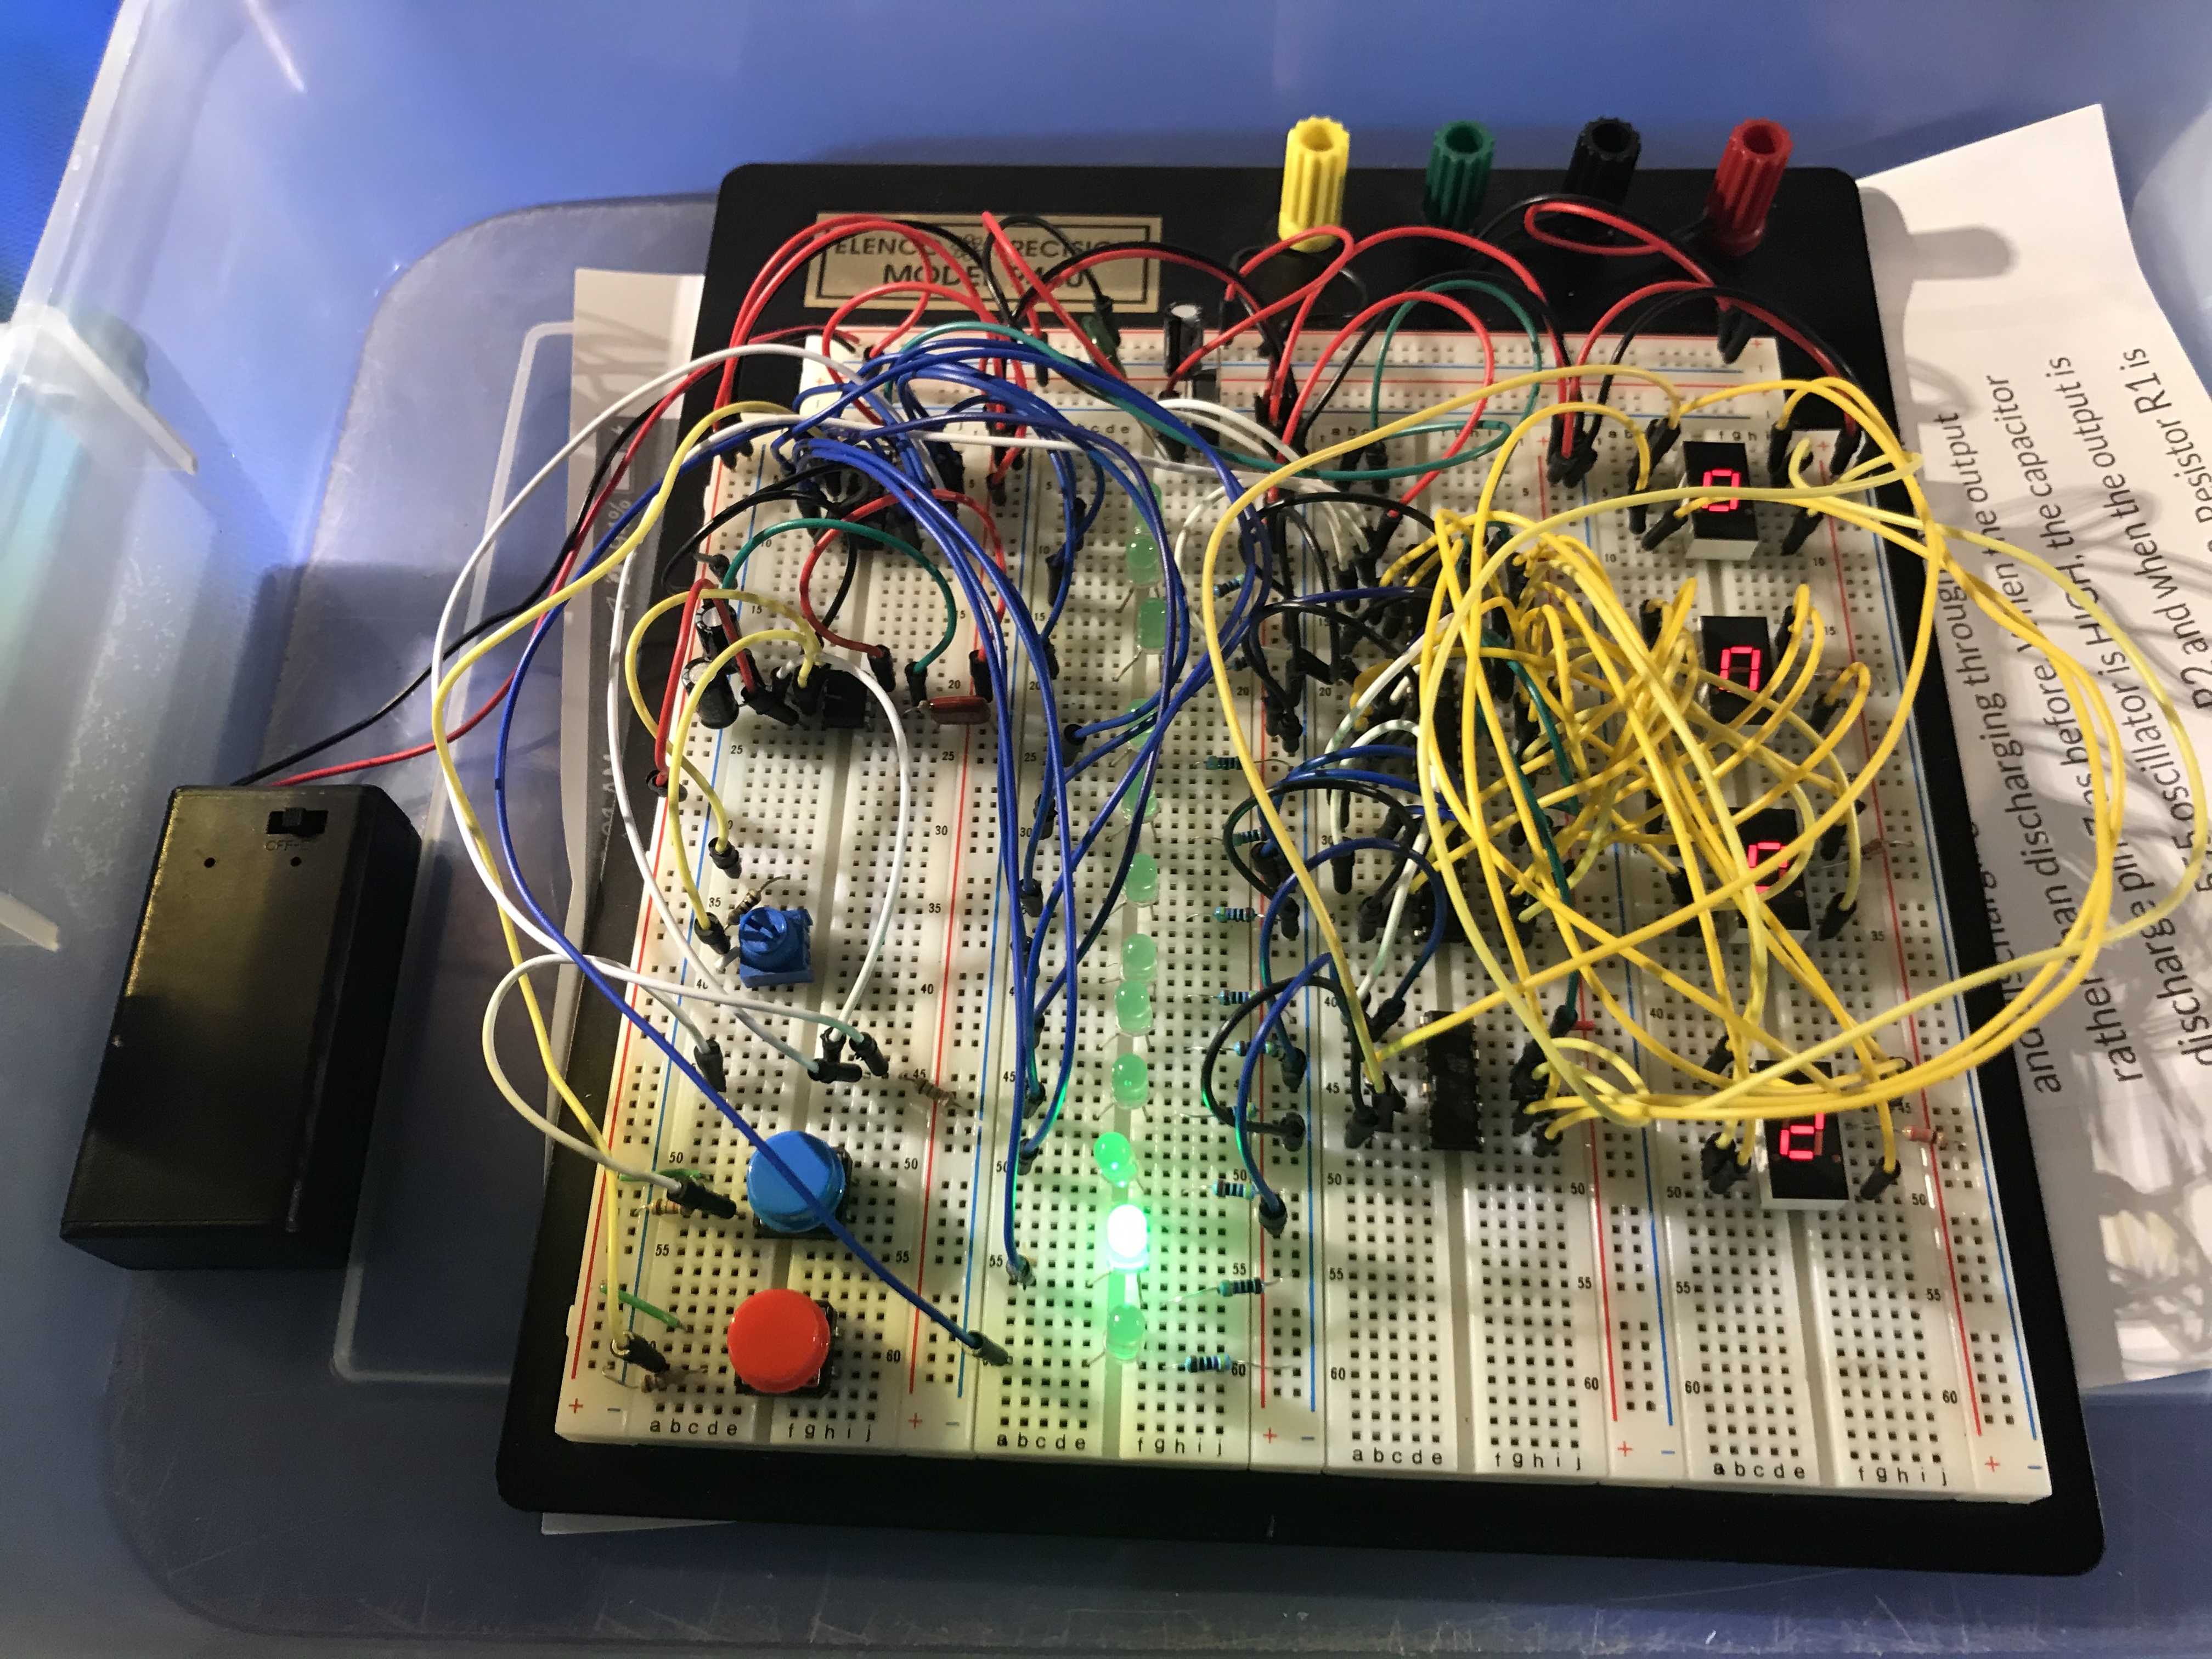
Breadboards are only good for the very first stage of prototyping
Breadboards are not permanent
Unfeasible for complex wiring
Cannot be made smaller
Not reproducible in mass quantities

Slide 4
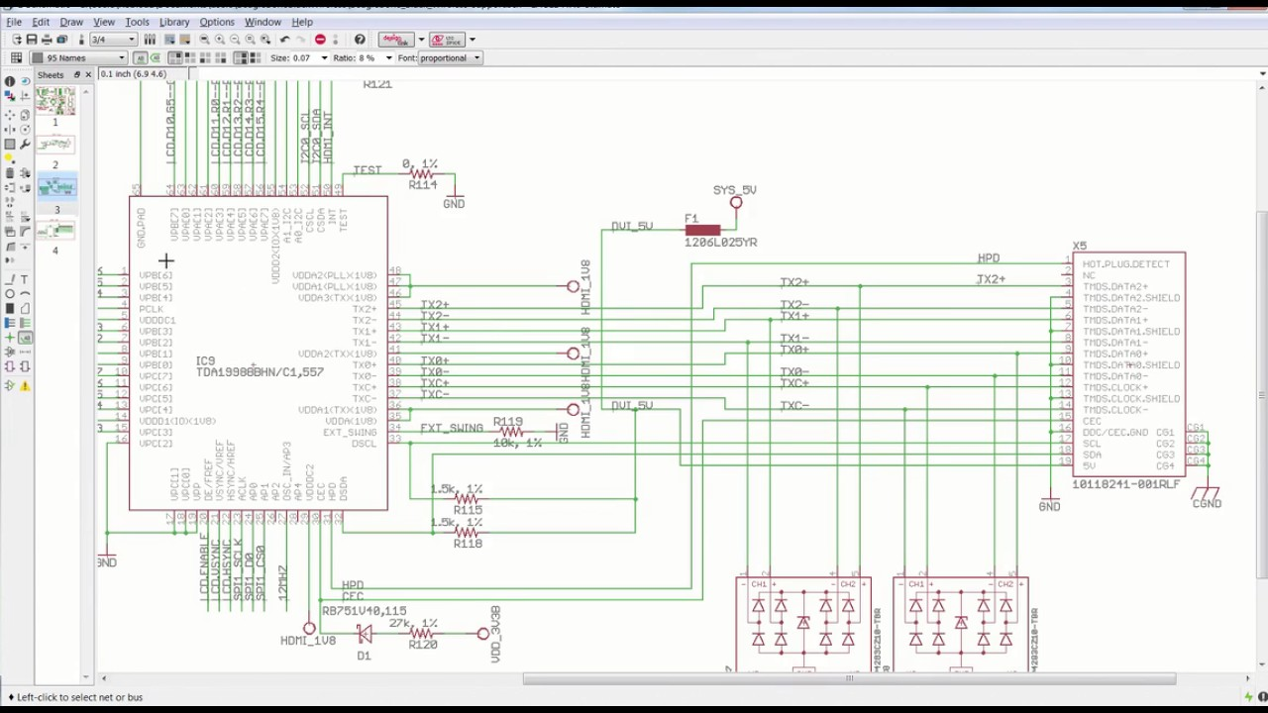
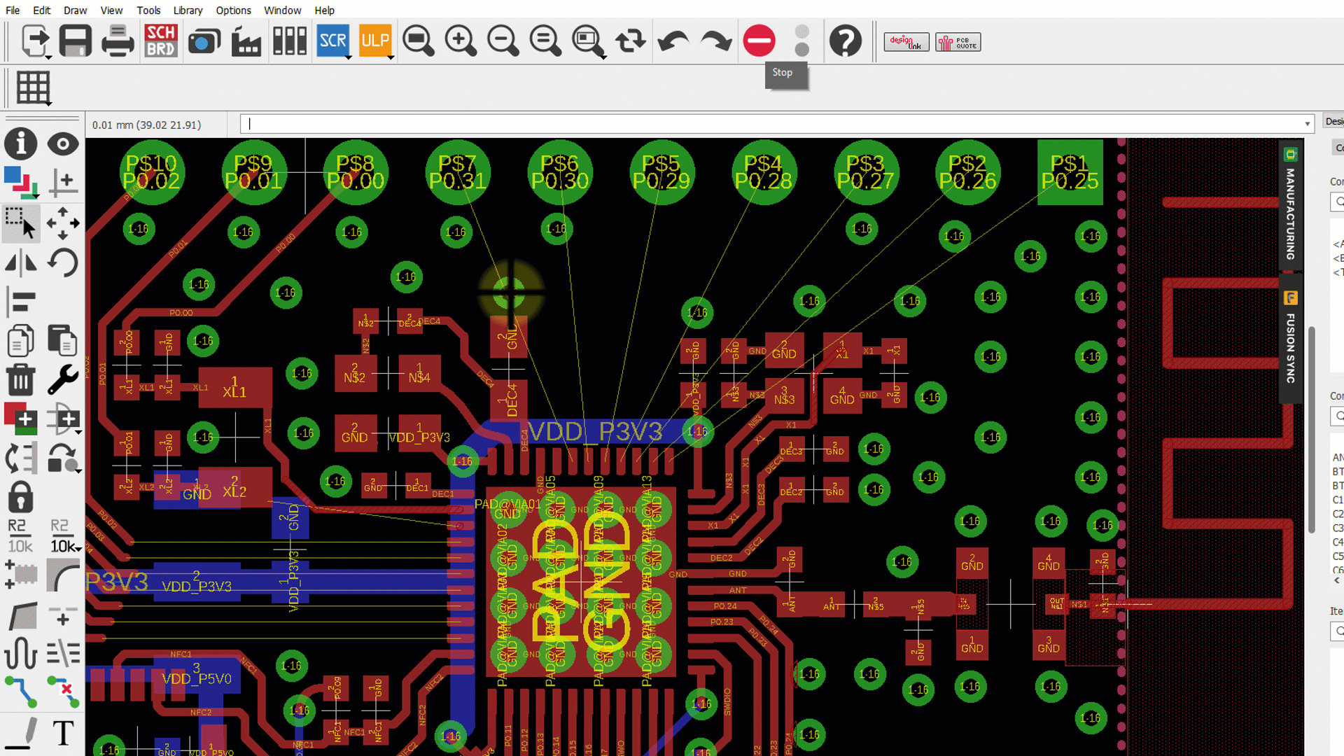
EDA = Electronic Design Automation
Schematic capture
Simulation
PCB layout
CAM processing

Slide 5
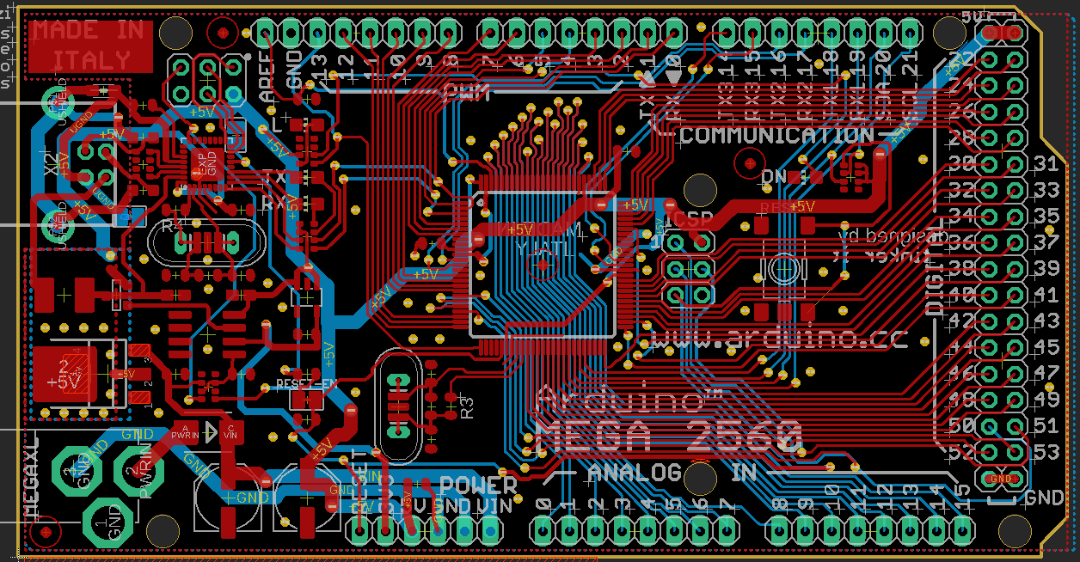
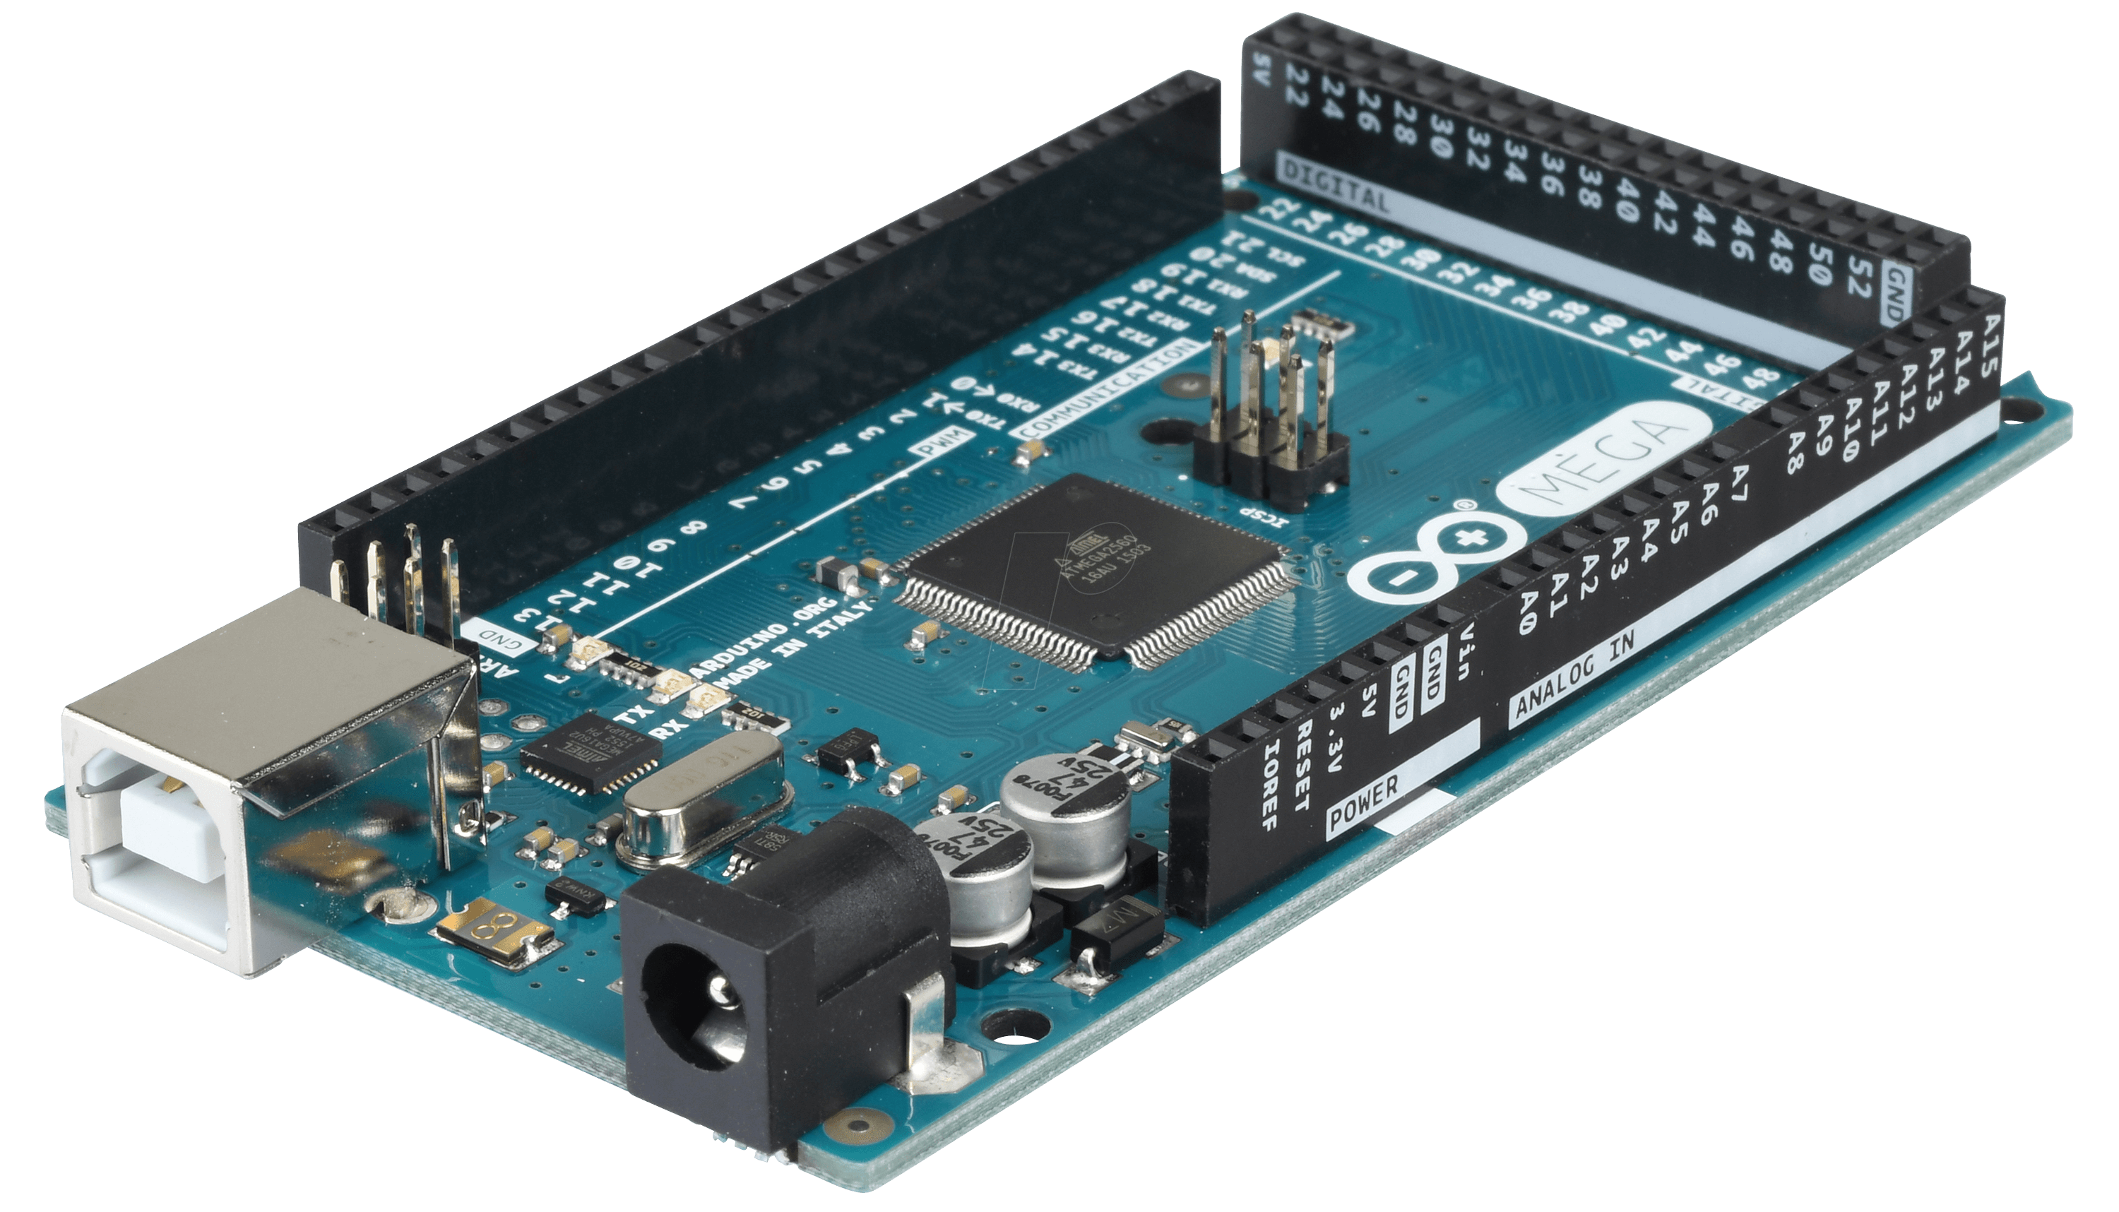
EAGLE is
Printed Circuit Board (PCB)
design software

Slide 6
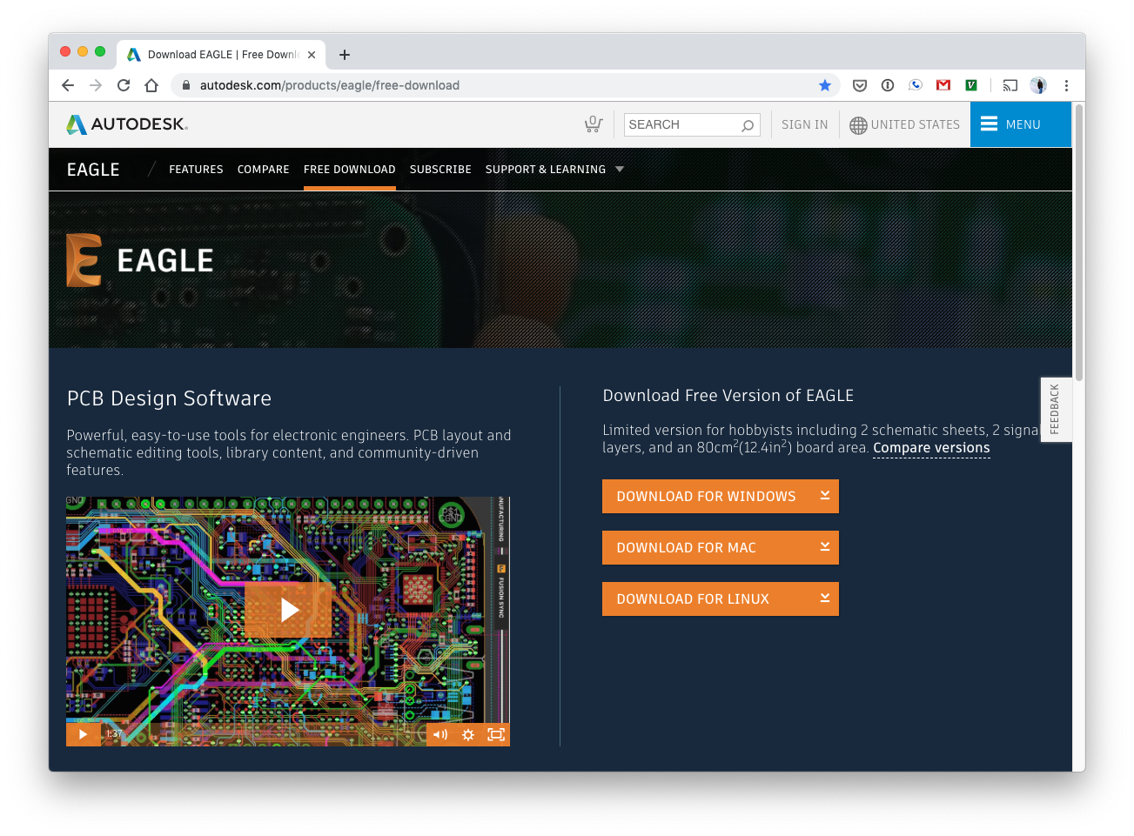
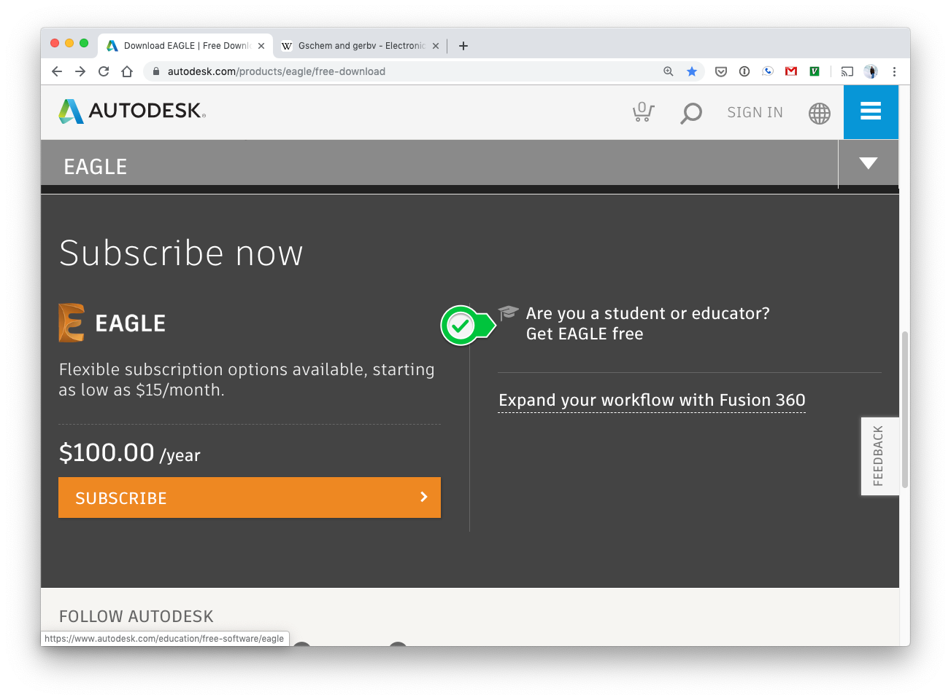
Installing EAGLE
Download latest EAGLE binary
Register Autodesk account
Register student license
https://www.autodesk.com/products/eagle/free-download

Slide 7
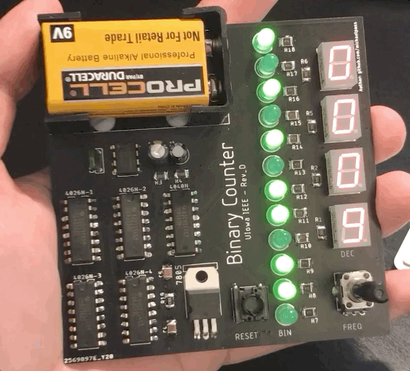
Today’s Project
Binary/decimal dual counter
Adjustable frequency
Reset button
9V power
$2 board, $20 in parts
github.com/michaelpass/IEEEcounter

Slide 8
Let’s Get Started!

Slide 9
Schematic Capture
PCB layout
GERBER file creation
Library part
Symbol & Footprint
Board manufacture
EAGLE Workflow

Slide 10
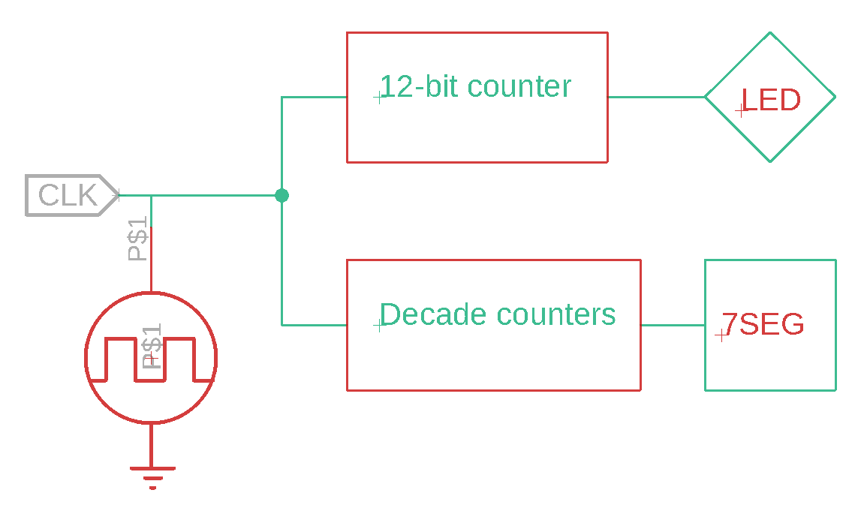
Functional Schematic

Slide 11
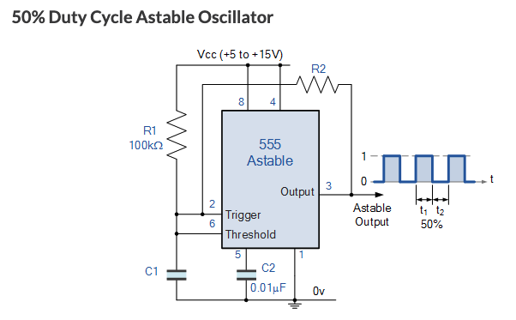
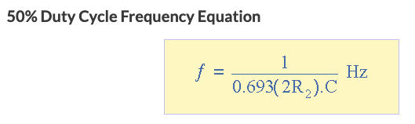
Step 1 – Signal Clock
Parts: NE555N
RK09D1130C2P

Slide 12
Step 2 – 12-bit ripple
Part: CD4040BN
Takes in clock signal
On negative edge, 12-bit output is incremented
Each “bit” is connected to LED to visualize output

Slide 13
Step 3 – Decade Counters
Part: CD4026N
LTS-4301JR
Takes in clock signal and increments on positive edge
When 10 is reached, carry-out pin goes high
This serves as the clock signal for next digit.
Positive edge incrementation can be turned into negative edge (to sync with) by setting clock pin HIGH and routing CLK signal to CI (clock inhibit)

Slide 14
Step 4 – Reset Switch
Part: 3FTH9
Because 12-bit ripple counter starts up randomly, it must be initially reset
12-bit ripple and decade counter resets are not directly linked
100k pull down resistor used to normally keep signal at GND

Slide 15
Step 5 – 9V-5V Power
Part: 1294 9V
9V battery clip ideal
9V must be stepped down to 5V
Linear regulator outputs necessary 5V
Decoupling capacitors used to smooth out regulated output

Slide 16
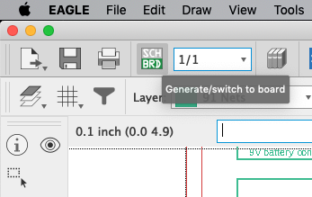
Step 6 – Board Creation

Slide 17
See You Next Time!

